Slide 1
The bipedal skeleton
Why was bipedalism selected for in early hominins and what are the physical differences of our bipedal skeleton compared with quadrupedal apes

Slide 2
Selection for bipedalism
The most significant feature of early hominin evolution was almost certainly walking bipedally.
Bipedalism is not common in nature.
Can we think of examples?
Humans have only two small points of contact with the ground...our feet. They allow us to balance, but are not very efficient on slippery surfaces.
Why then was bipedalism selcted for in Africa all those years ago?...

Slide 3
Selection for bipedalism
What is it about this landscape that caused natural selection of those early hominids that were more bipedal than others, thus changing the genotype over time.
They never “chose” to be bipedal, they never deliberately developed their pelvic bones to better suit walking on two legs, but some of them would have had minor differences in phenotype (and therefore genotype) that would have been a small advantage (energy saving/vigilance) for walking between the trees which were, by this stage, further apart.

Slide 4
The push to evolve
Around 5 million years ago the African climate changed. Cooler and drier climate meant areas of dense forest changed to open savaanah (grassland with scattered trees experiencing seasonally dry, hot conditions.
The divergence of hominins from their ape-like, arboreal (living in trees) ancestors took place as major adaptations to the changing environment occurred within the hominid groups.
It is thought bipedalism (habitually walking on two legs) evolved first, followed by changes in teeth and jaws, and finally the development of the brain which allowed for the more complex cultural evolution of humans compared to other present day apes.
The evolution of humans has occurred through natural selection, where the best adapted individuals survived or outcompeted others for breeding partners, thus passing on their successful alleles to their offspring. Theses successful alleles then increased in frequency in the gene pool.

Slide 5
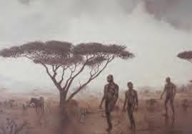
The advantages of bipedalism
How could being bipedal in these environments offer a selective advantage?
Make a list of factors that are advantages of our bipedal nature and why they are advantageous.
Carrying things - Can gather food and bring back to a group, can carry children while carrying out tasks...
Keeping cool - Less exposure to the sun...
Displaying to others - Erect posture and forward facing eyes allows for social communication
Being vigilant - Extra height means predators can be seen from further away...
Energy efficiency - For walking bipedal is more efficient (note: running quadrupedal is still better)...
Foraging and harvesting - Can reach higher and use balance to reach food...

Slide 6
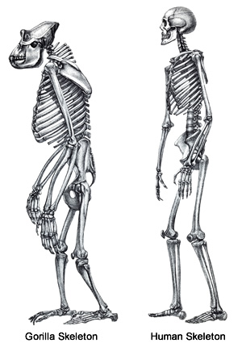
Spot the difference
How does our bipedal skeleton differ to the gorillas quadrupedal skeleton?

Slide 7
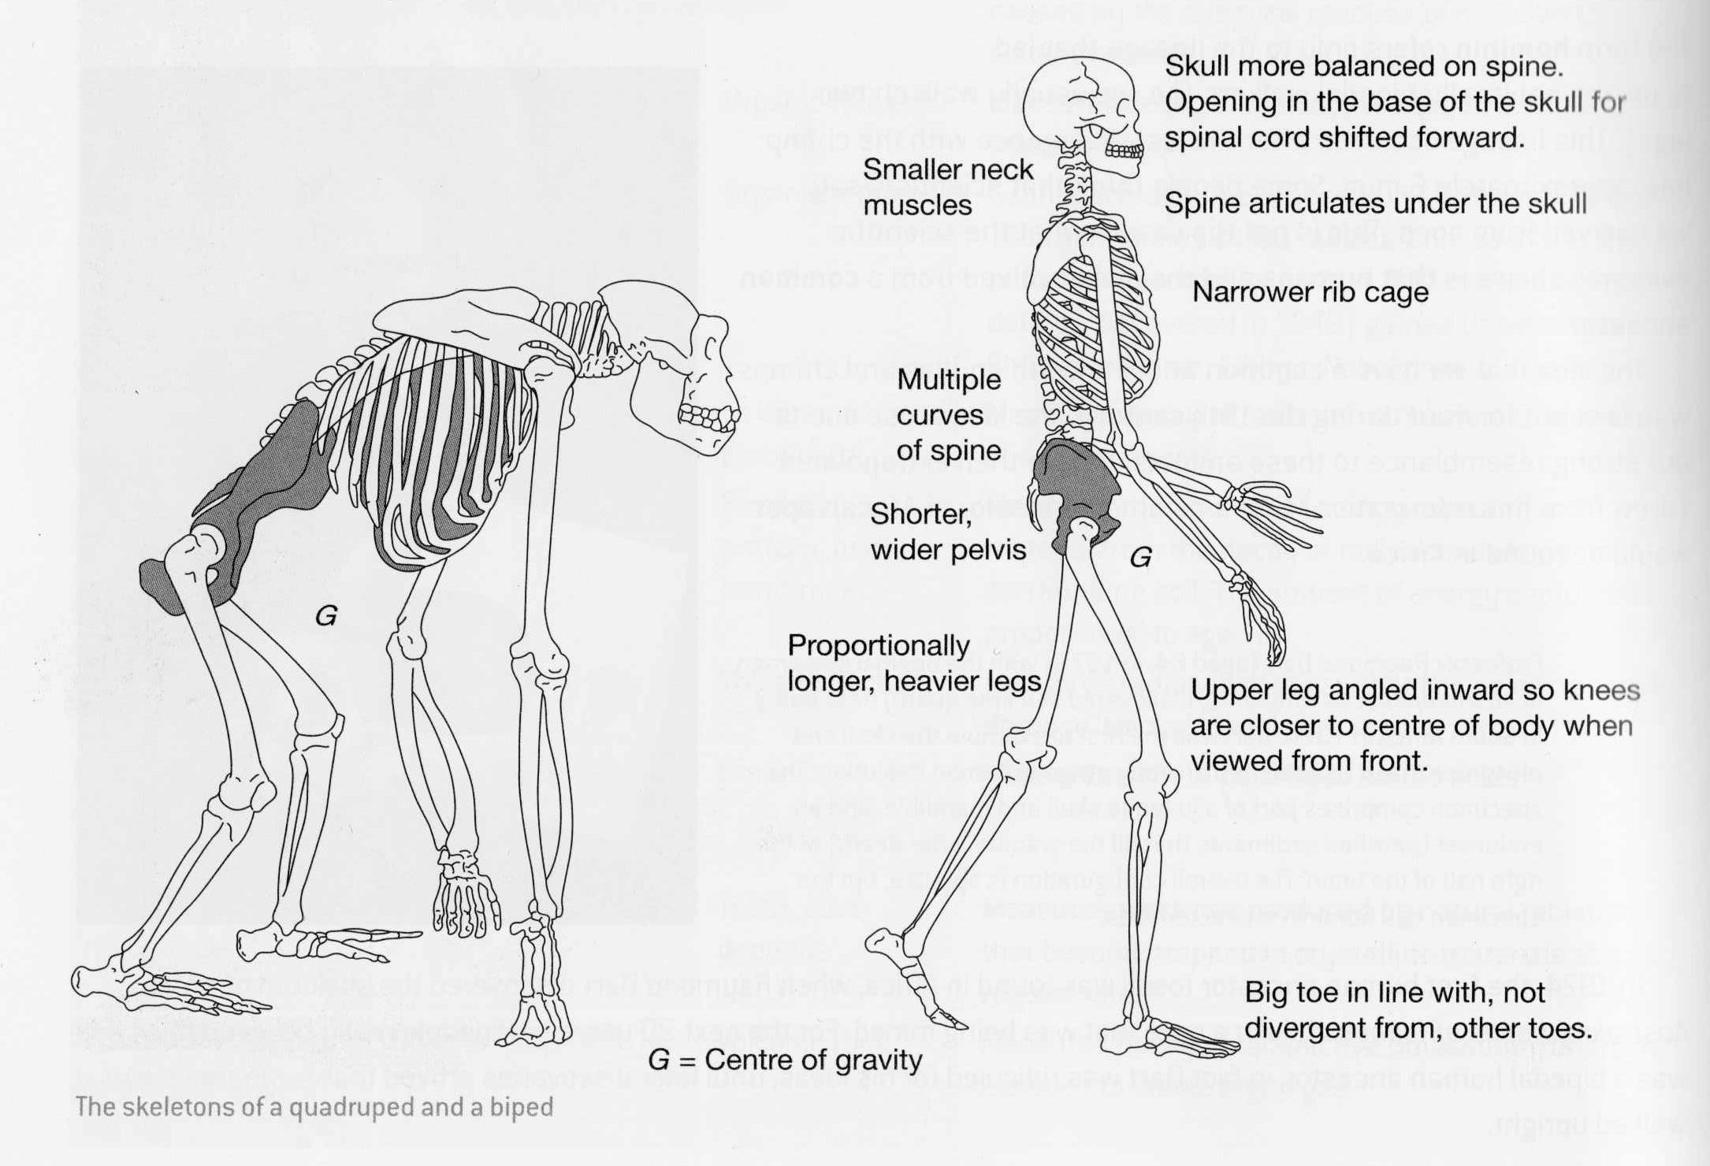

Slide 8
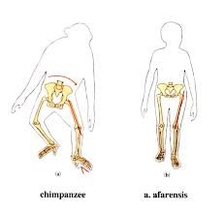

Slide 9
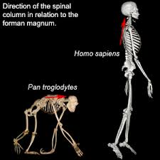
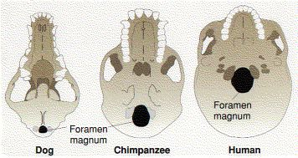

Slide 10
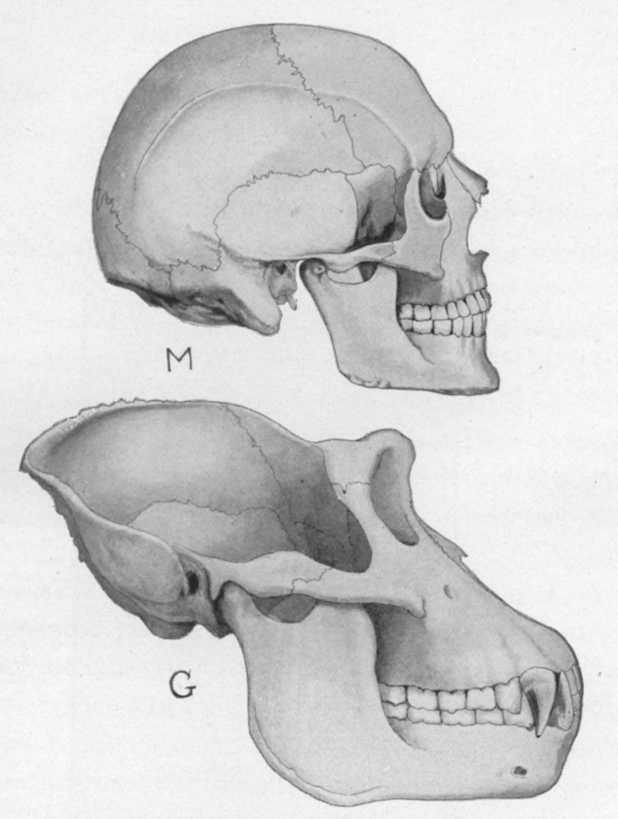
Spot the difference
How does our skull differ to the gorillas skull?
Sagittal crest
Foramen magnum in the centre of the skull
Nuchal crest
Brow ridge
Foramen magnum near the rear
Features of a homosapiens skull | Features of a gorilla skull
Lack of sagittal crest | Large sagittal crest (for attachment of jaw muscles)
Lack of nuchal crest | Nuchal crest (for attachment of jaw muscles)
Reduced zygomatic arch | Large zygomatic arch (for strong chewing in predominantly herbivorous animals)
Limited brow ridge | Strong brow ridge (for support when forces of eating are applied)
Reduced canines | Canines (often used for display)
Foramen magnum is in the centre of the skull base | Foramen magnum is near the rear
Small mandible | Large mandible (for chewing tough plant material)
zygomatic arch
Sagittal crest
Foramen magnum in the centre of the skull
Canines
Nuchal crest
Brow ridge
Foramen magnum near the rear
zygomatic arch
Mandible (jaw)
Canines

Slide 11
The skulls
Sagittal crest
Foramen magnum in the centre of the skull
Other physical features of the skull that are commonly used to separate humans from our closest ape relatives include:
rounded braincase with thin skull bones
high, vertical forehead
vertical face
small brow ridges
short jaws
centrally located foramen magnum (the hole in the base of the skull through which the spinal cord runs)
skull balanced on a vertical backbone
Nuchal crest
Brow ridge
Foramen magnum near the rear
zygomatic arch
Canines
Interesting fact: The physical features listed above are, however, also found in baby chimpanzees and other immature apes, which suggests that human evolution has involved the retention of juvenile features within adults. This evolutionary process is called neoteny.

Slide 12
Workbook pages
Read and complete page 204-212 “Level 3 Biology learning workbook” for more in depth detail and questions to check understanding.

